Slide 1



Slide 2

Psychology is am empirical science dealing with bio-social behavior with reference to its environment.
Psychology is scientific study of behavior and mental processes.
The term “Psychology” come from two Greek words, “psyche” meaning the soul, and “logos” referring to the study or talk of the subject.
Psychology is a science because it follows the empirical method. Empiricism emphasizes objective and precise measurement. Psychology and the other behavioral or social sciences (sociology, anthropology, economics, political science) are not as precise in their measurements as are biology, chemistry or physics, but to the extent that psychologists use empirical evidence, their findings may be referred to as scientific.
Goals of Psychology
Observation,description,explaination and prediction of behavior through systematic methodology.

Slide 3

Structuralism:
Structuralism was the first school of psychology and focused on breaking down mental processes into the most basic components. Researchers tried to understand the basic elements of consciousness using a method known as introspection. Wilhelm Wundt, founder of the first psychology lab in 1874 in Leipzig, Germany. He was an advocate of this position and is often considered the founder of structuralism, despite the fact that it was his student, Edward Titchener who first coined the term to describe this school of thought.

Slide 4
2. Functionalism:
Developed by William James Functionalism is an early approach to psychology that concerned with what the mind does-the functions of mental activity-and the role of behavior in allowing people to adapt to their environment.

Slide 5

Structuralism was based on the notion that the task of psychology is to analyze consciousness into its basic elements and investigate how its elements are related.
Method of introspection – careful, systematic self observation of one’s own conscious experience.
Wilhelm Wundt (father of psychology) & Edward Titchener
Functionalism was based on the belief that psychology should investigate the function or purpose of consciousness, rather than its structure.
Impressed by Charles Darwin
William James - Not what mind does, but why it does it.
Structuralism (1870-1900)
Functionalism (1880-present)

Slide 6
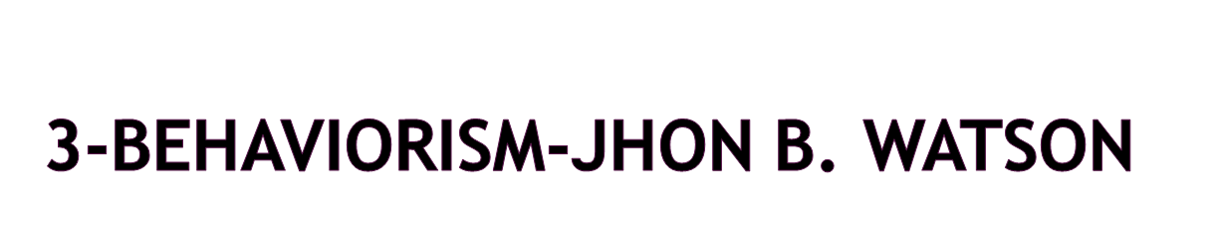
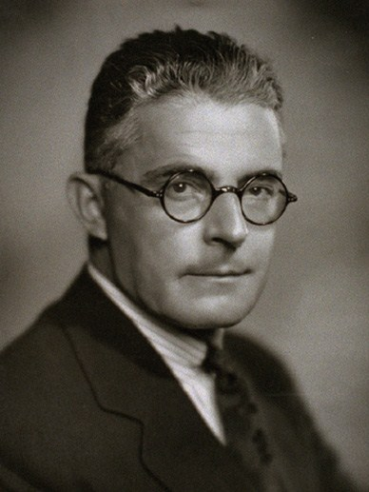
(1878-1958)
Behaviorism is a theoretical orientation based on the premise that scientific psychology should study only observable behavior.
Watson’s argument- All behavior is a result of conditioning and the environment shapes behavior by reinforcing specific habits.
Denied the existence of inborn or innate behavioral tendencies.
Behavior refers to any overt (observable) response or activity by an organism.
Nature vs nurture: Genetics vs experience
Stimulus-organism-response
Ivan Pavlov’s discovery
Skinner-free will

Slide 7
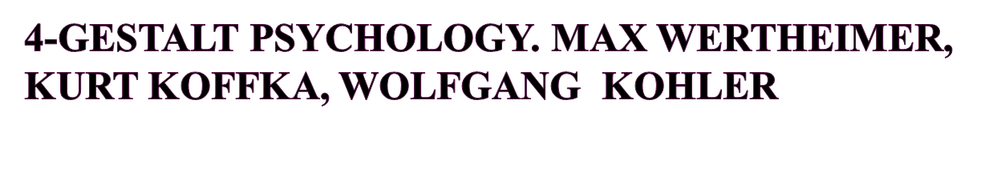
Gestalt- German word meaning “form” or “configuration” Overall shape..
Gestalt Psychologist's primary interest was perception they believed that perceptual experiences depend on the patterns formed by stimulus and on the organization of experience.
Whole pattern of sensory activity, the relationships and organizations within this pattern.
The whole is different from the sum of its parts because of the relationships between the parts.
School of thought that emphasized the total experience of the individual and not just parts of the mind or behavior.

Slide 8

Treated people with troubles of psychological problems with innovative procedures called Psychoanalysis.
He brought unconscious on the surface
According to him, unconscious contains the thoughts, memories and desires that are well below the surface of conscious awareness but that nonetheless exert great influence on behavior.
Psychoanalytic theory explains personality, motivation, and mental disorders by focusing on unconscious determinants of behavior.

Slide 9
Our behavior and feelings as adults are rooted in our childhood
experiences.
  Relationships (particularly parenting) are of primary importance in determining how we feel and behave.
  Our behavior and feelings are powerfully affected by the meaning of events to the unconscious mind.
  Information can be obtained from dreams, irrational behavior and what patients in therapy say.
  The personality is made up of three distinct structures: id, ego and super ego.
  Defense mechanisms are used to protect the ego, e.g. repression.
  Children develop through a series of fixed stages: oral, anal and
  phallic.

Slide 10
6. Humanistic Model:
Developed by Carl Rogers and Abraham Maslow (1950s )
Assumptions:
A healthy mental attitude is dependent on taking personal responsibility, recognizing the existence of free will, and striving towards personal growth and fulfillment.
Individuals have a need for self actualization.
People are naturally good, with the potential for personal growth if they are provided with the appropriate circumstances.
Rogers (1959): if in early life children receive unconditional positive regard they will develop satisfactorily. However, if they experience conditions of worth, they are prevented from realizing their potential and becoming self-actualised.
People use distorted thinking to defend themselves, e.g., by rationalization, that is distorting their real motives to fit in with their self-concept.

Slide 11
7-Cognitive Model Aron T. Beck and Albert Ellis.
  It is the study of cognition and the underlying mental processes such as reasoning, problem solving, language, concept, creativity, motivation, instincts, beliefs and memory.
The cognitive school focuses on how people structure their experiences and how they make sense of them.
They view individual as an active agent who can think, manipulate, interpret and design their environment.
The cognitive model emphasizes that the cause of many psychological disorders (abnormalities) is due to dysfunctional thought processes and the absence of sufficient thinking and planning.

Slide 12

Today’s Perspectives
Biological
  Biological bases of behavior
Humanistic
  Free will
  Natural tendency to be in control of our lives
Psychodynamic
  Behavioral influences of inner forces
Cognitive
  How people think, understand, and know about the world
Behavioral
  Focus on observable events
Socio cultural
Role of customs,society on our behavior

Slide 13

BIOLOGICAL:
1.Biological perspective is the scientific study
of the biological bases of behavior and
mental states, very closely related to
neuroscience.
2. The psychoanalytic perspective:
The psychoanalytic perspective originated
with the work of Sigmund Freud. This perspective
emphasizes the role of the unconscious mind,
early childhood experiences, and interpersonal
relationships to explain human behavior and to
treat people suffering from mental illnesses.

Slide 14
3. Behavioral Perspective:
Behavioral psychology is a perspective that focuses on learned behaviors. Today, the behavioral perspective is still concerned with how behaviors are learned and reinforced.
4. Humanistic Perspective:
During the 1950s, a school of thought known as humanistic psychology emerged. Influenced greatly by the work of prominent humanists such as Carl Rogers and Abraham Maslow, this perspective emphasizes the role of motivation on thought and behavior.

Slide 15
5. Cognitive Perspective:
During the 1960s, a new perspective known as cognitive psychology began to take hold. This area of psychology focuses on mental processes such as memory, thinking, problem solving, language and decision-making.
6. Social cultural Perspective:
The sociocultural perspective maintains that behavior and mental processes are shaped not only by prior learning experiences (the behavioral perspective) or intra-psychic forces (for instance, the unconscious) but also by the social or cultural context.

Slide 16

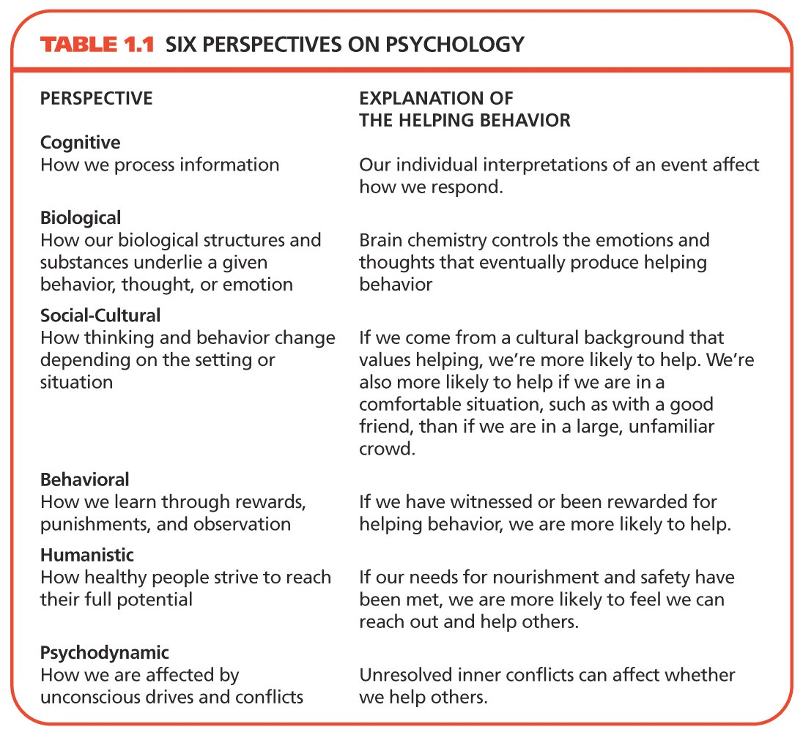

Slide 17
Applying these perspectives: Case example
Bilal was born in Lahore to extremely religious parents who raised him in a rather strict moralistic manner. Bilal’s memories of his father always included feelings of fear and intimidation. His memories of his mother were unclear, except that she had often been bedridden and had attempted suicide on two occasions. He grew up shy, reserved, and by all external standards, was a quiet, well-behaved child. He did well in school and college, obtaining nearly straight A’s, but some of his friends were concerned about his introverted behavior and occasional bouts of sadness. Toward the end of his college, Bilal suffered a mental breakdown characterized by pessimism and hopelessness.
How can Bilal’s problem be explained in light of the six psychological perspectives?

Slide 18

1.Experimental Psychology:
a general title applied to a variety of psychologists who are trained in designing and conducting research in specific basic areas like learning, sensation and perception, human performance, and motivation and emotion. A research oriented doctoral degree (Ph.D.) is usually needed.
2. Biopsychology:
Take a comparative and genetic perspective in the experimental analysis of basic psychological processes as they relate to the many ways in which animal species adapt, survive, reproduce and evolve

Slide 19
3. Developmental Psychology:
Concerned with growth and development from conception till death. All aspects of the animal or human organism (physiological, biological, physical, cognitive, emotional, social, cultural) may be studied.
4. Social Psychology:
study the ways in which the social context affects the behavior of the individual and groups in the real world and the laboratory. Social psychologists focus on topics such as social roles, attitude formation and change, affiliation, interpersonal attraction and interaction, conformity, and group processes

Slide 20
5. Industrial / Organizational Psychologists:
Study the relation between individuals and work. They are employed in business and industry, in government, and in colleges and universities, and may perform a variety of jobs. An industrial/organizational psychologist working in industry may study how work is organized; suggest changes to improve the satisfaction of employees, the quality of the organization's services, and productivity; consult with management on the development of effective training programs for employees; design programs for the early identification of management potential; administer career counseling and pre retirement counseling programs; develop affirmative action programs; recommend changes in job definition; design a system of performance evaluation. HRM,Marketing,Consumer

Slide 21
6. Educational Psychologists:
Are concerned with a range of activities from initial design through development and evaluation of both materials and procedures for education and training. Such positions exist in public schools, in the military, in private research and development companies, and in industrial concerns. They may deal with analyzing education and training needs, with developing materials for instruction in various media, with designing the best conditions for instruction, and with evaluating the effectiveness of instructional programs.

Slide 22
7. Clinical Psychology:
We are concerned with the diagnosis and treatment of psychological disturbances. Their responsibilities range from administering and scoring psychological tests, to engaging in therapy, to supervising the training of graduate students in the delivery of mental health services, to administering a community mental health program. Some clinical psychologists obtain faculty positions in a college or university some serve as consultants or as therapists.

Slide 23
8. Counseling Psychology:
We are concerned with counseling, teaching consulting research, and/or administration. In this we are particularly concerned with the role of education and work in an individual's functioning, and with the interaction between individuals and the environments in which they live. Typically, counseling psychologists work with normal or moderately maladjusted persons, individually or in groups. This work includes use of traditional counseling interview methods, interest, ability and personality tests, and educational and occupational information.

Slide 24
9. Cross-cultural psychology
Is a branch of psychology that looks at how cultural factors influence human behavior. They study whether behavior is culture-universal or culture-specific.
10. Forensic Psychology:
It is defined as an intersection between psychology and the criminal justice system. Forensic psychologist work in legal area assisting in jury selection, evaluating disability claims. and providing expert testimony during court trials.

Slide 25
11. Environmental psychology:
Is an interdisciplinary field focused on the interplay between humans and their surroundings. The field defines the term environment very broadly including all that is natural on the planet as well as social settings, built environments, learning environments and informational environments.
12. Psychiatry:
Psychiatry is a branch of medicine practiced by physicians with an M.D degree who specialize in abnormal psychology and therapy. The difference between clinical psychologist and psychiatrist is they can prescribe medicines, whereas clinical psychologist can only prescribe mild medication.

Slide 26
13. Psychology of Women
This class explores the female experience within the world. Many times people ask why there isn't a Psychology of Men class. There are plenty of them, as most classes are designed with the male as the baseline. This class looks at how women differ from the baseline and how the female experience is also valid in its own right, not as just an "other."
14.Health Psychology:
It explores the relationships of psychological and physical ailments or disease. It promotes and maintain our physical and mental health.
Psychosomatic and somatic disorders.

Slide 27

APA Research Standard

Slide 28

Each individual scientist has an ethical responsibility to seek knowledge and to strive to improve the quality of life. Scientists should:
Carry out research in a competent manner;
Report results accurately;
Manage research resources honestly;
Fairly acknowledge, in scientific communications, the individuals who have contributed their ideas or their time and effort;

Slide 29

Planning Research
Responsibility
Compliance with law and standards
Institutional Approval
Judging benefit and cost
Informed consent
Debriefing
Plagiarism & self plagiarism
Reporting the results.
Types of Research: Quantatative,qualitative and Mix research

Slide 30


Slide 31

All methods or tests used by researchers and psychometricians should be
Valid. Reliable Standardized.
To describe, predict, and explain behavior and mental processes, psychologists use three basic methods:
Description(case studies, surveys, and naturalistic observations)
Correlation
Experimentation

Slide 32
1. CASE HISTORY:
An in-depth study of one person. In a case study, nearly every aspect of the subject’s life and history is analyzed to seek patterns and causes for behavior. The hope is that learning gained from studying one case can be generalized to many others. Unfortunately, case studies tend to be highly subjective. We use
Child book, Biographical and clinical method
2.Focus group: Group interview are conducted to collect information through discussion. We analyze, transcript based ,tape recording.

Slide 33
2. NATURALISTIC OBSERVATION:
Naturalistic observation is a method of observation, commonly used by psychologists, behavioral scientists and social scientists, that involves observing subjects in their natural habitats. Researchers take great care in avoiding making interferences with the behavior they are observing by using unobtrusive methods. Objectively, studying events as they occur naturally, without intervention.

Slide 34

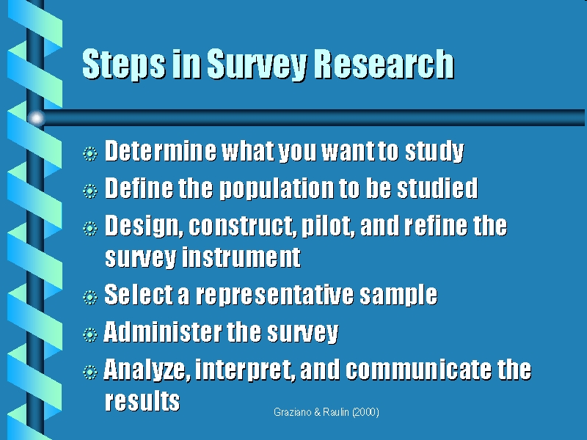
3. SURVEY METHOD:
Survey is a method of scientific investigation in which a large sample of people answer questions about their attitudes or behavior.

Slide 35
4. EXPERIMENTAL METHOD:
The experimental method involves manipulating one variable to determine if changes in one variable cause changes in another variable. This method relies on controlled methods, random assignment and the manipulation of variables to test a hypothesis.
An experiment is a study of cause and effect. It differs from non-experimental methods in that it involves the deliberate manipulation of one variable, while trying to keep all other variables constant.

Slide 36
Parts of a Simple Experiment:
Problem: Select a solvable problem
The experimental hypothesis: a statement that predicts that the treatment will cause an effect. The experimental hypothesis will always be phrased as a cause-and-effect statement.
The independent variable: the treatment variable that is manipulated by the experimenter.
(stimulus)
The dependent variable: the response that the experimenter is measuring. (response)
The control group: made up of individuals who are randomly assigned to a group but do not receive the treatment. The measures takes from the control group are then compared to those in the experimental group to determine if the treatment had an effect.
The experimental group: made up of individuals who are randomly assigned to the group and then receive the treatment. The scores of these participants are compared to those in the control group to determine if the treatment had an effect.

Slide 37
Example:
Hypothesis: an aspirin a day reduces the likelihood of a heart attack.
Independent variable: Aspirin
Dependent Variable: the number of heart attacks.
The experimental group: would take an aspirin each day
The control group: would take a placebo, such as a sugar pill, that resembles an aspirin but has none of the effects attributed to aspirin.
After a few months or years of pill-taking, the number of heart attacks would be measured as the dependent variable. If the aspirin-takers (experimental group) had a significantly smaller number of heart attacks than the placebo-takers (control group), then the research hypothesis (aspirin-taking reduces heart attacks) would be supported.

Slide 38
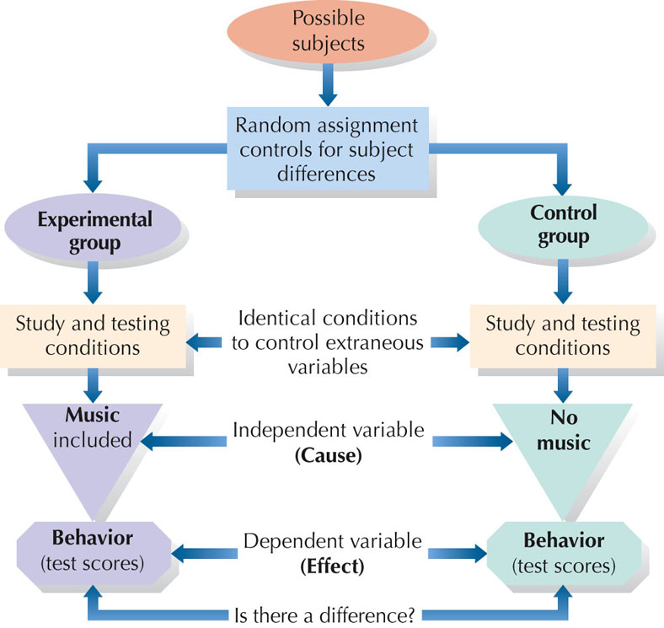

Slide 39
5. CORRELATION:
Correlation studies are used to look for relationships between variables. There are three possible results of a co relational study: a positive correlation, a negative correlation, and no correlation. The correlation coefficient is a measure of correlation strength and can range from –1.00 to +1.00.
Positive Correlations: Both variables increase or decrease at the same time. A correlation coefficient close to +1.00 indicates a strong positive correlation.
Negative Correlations: Indicates that as the amount of one variable increases, the other decreases (and vice versa). A correlation coefficient close to -1.00 indicates a strong negative correlation.

Slide 40

Which research methodology is being used in the following scenario? Give rationale.
A researcher wants to conduct a study on the impact of a relaxation therapy on anxiety. He makes two groups of participants, each group has 10 participants. All the participants of the study are experiencing anxiety. Group A (10 Participants) are given the relaxation therapy for one week whereas, Group B (10 Participants) are not given any therapy. Their responses and improvements are checked at the end of the week and compared with each other to check the impact of the therapy on the participants.

Slide 41

Method: Experimental Method
Rationale:
  Because there is an experiment being conducted.
  Because there is an experimental and control group.
  Because the impact of something is being observed on a problem.
  Because only one group (experimental) is getting the therapy.

Slide 42

Which perspective explains the following case studies? Give rationale.
A 16 years old boy has continuous dreams about a man beating his mother. In his dream he sees himself as a 4 years old child crying and standing in one corner. After visiting the school counselor, when asked about his childhood memories, he explains that his father used to beat his mother when he was a child and he used to listen to the screams of his mother and was unable to do anything about it.

Slide 43

Perspective: Psychoanalytic
Rationale:
  The boy’s experiences in the early childhood were governing his dreams and his unconscious mind was bringing the childhood memories in the form of dreams.
  There are unconscious determinants (childhood memories) of his present behavior (dreams).

